Slide 1




Microsoft

Slide 2
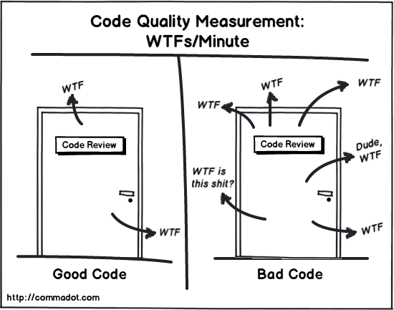

Slide 3


Slide 4


Supported Platforms & Languages

Slide 5
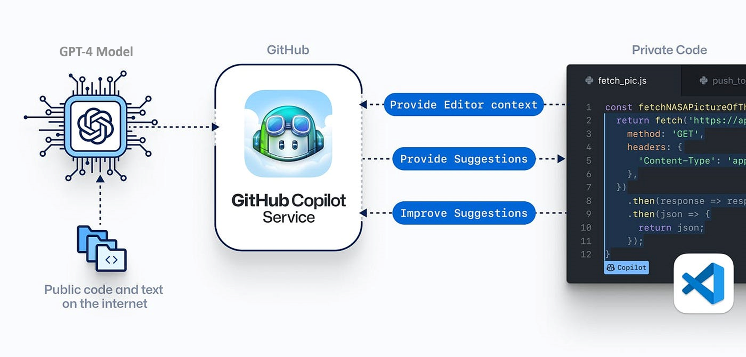
Internal Structure

Slide 6

Helpers
Ghost text
Inline chat
Chat window
Terminal help
Github Copilot CLI
(gh copilot suggest / explain)

Slide 7
Features
Code completion
Code review
Code documentation
Code formatting
Meaningful variable name creation
Alternative library sample suggestions
Learning path creation
@workspace /new -->
generates a new project
@terminal /explain #terminallasterror
Chat view in the terminal
Command Line Interface

Slide 8
ChatGPT vs GitHub Copilot (GHCop)
IDE Support & Integration
Context transport
More info must be provided to C-GPT
What our process is
What type of our project is
What our environment is, etc…
Rate limitation
There is no rate limit in GHCop
Data can be used in C-GPT but GHCop (>=Business) doesn't use for training purposes
Notes:
GitHub CoPilot trust center
https://resources.github.com/copilot-trust-center/

Slide 9
Prompting
TASK
Create a python study plan for me.
CONTEXT
Rewrite the entire study plan and update it with
resources and links. Present the URLs in a plain format
(e.g., 'https://example.com’).
FORMAT
Make the study plan 4 weeks. I have 10 hours every week to study.
TONE & ROLE
Act as a Berkley data science professor.
I have experience with multiple programming languages and
have worked with tech for 10 years.
Rewrite the study plan to take this into account.
EXAMPLE
Create hands-on assignments for each week
that teaches me to use the techniques.
It should take around 5 hours to complete.

Slide 10
Demos
Beautify and secure your prompts
Chat with your database
DDD or EDD principal appliance using Arc.Pict.
Code formatting and library expansion
Learning path creation
Chrome extension creation
XML to JSON data convertion
EventLog analysis (security evt)
Youtube video downloader
Markdown input creation for MarkMap
Windbg dump file analysis with GHCop
Convert OneNote files into Markdown format
Formula calculation
Char animation of a camera/video capture

Slide 11



Notes:
Sunum ile aktarıcaklarımız bunlar, sorularınız var ise alabiliriz.
Bizi dinlediğiniz için teşekkürler.

Slide 12
